Slide 1

SENTIMENT ANALYSIS IN THE EDUCATION SECTOR
SREEJONI BANERJEE
PRN: 20070243034

Slide 2
Introduction
Feedback is an essential component of life, whether it concerns politics, events, products, or education. Positive feedback will increase sales, whilst negative feedback will result in a decrease in sales.
The method of analysis of the mood/opinion of people through subjective feedback and deriving relevant intelligence is known as sentiment analysis. Sentiment analysis (or opinion mining) is a natural language processing (NLP) technique.
The purpose of sentiment analysis is to examine people's opinions. It focuses on emotions (happy, sad, angry, etc.).
Students' feelings and views are a great source of information to examine their attitudes about a course, topic, or teachers and modify policies and measures for the improvement of the institution as a whole.
The most significant advantage of student evaluations is arguably the direct, constructive criticism it gives teachers, allowing them to improve their expertise, curricula, and teaching methods to improve the learning experiences for students.

Slide 3
Methodology
Data Collection
Data was collected using Google Forms.
Around 1000 data points are present.
Data Pre-processing
Grammar and Spell-check.
Removal of duplicates and NA values.
Topic Detection
One Topic Prediction (KNN and Random Forest model)
All Topic Prediction (Extreme Gradient Boosting model)
The feedback column was taken and formed an excel sheet.
Sentiment Analysis
Find a model that fits best for our data (Random Forest, Naïve Bayes, SVM, Bagging, XGBoost, Decision Tree)
Detect sentiment and divide it into 10 types (anger, anticipation, disgust, fear, joy, sadness, surprise, trust, negative and positive)
Recommendation
Using n-grams, correlation analysis and cluster analysis to find recommendations based on the feedback.

Slide 4
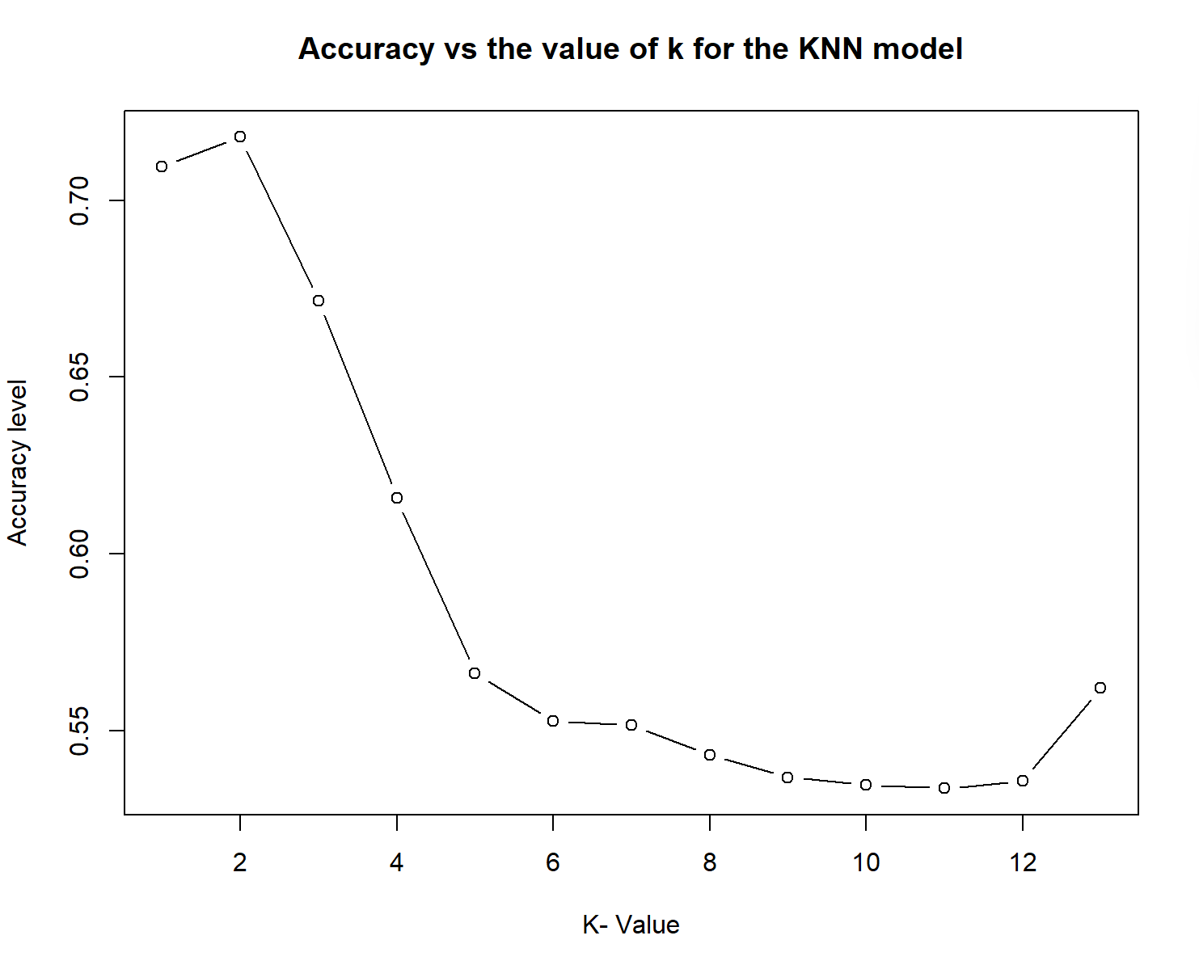
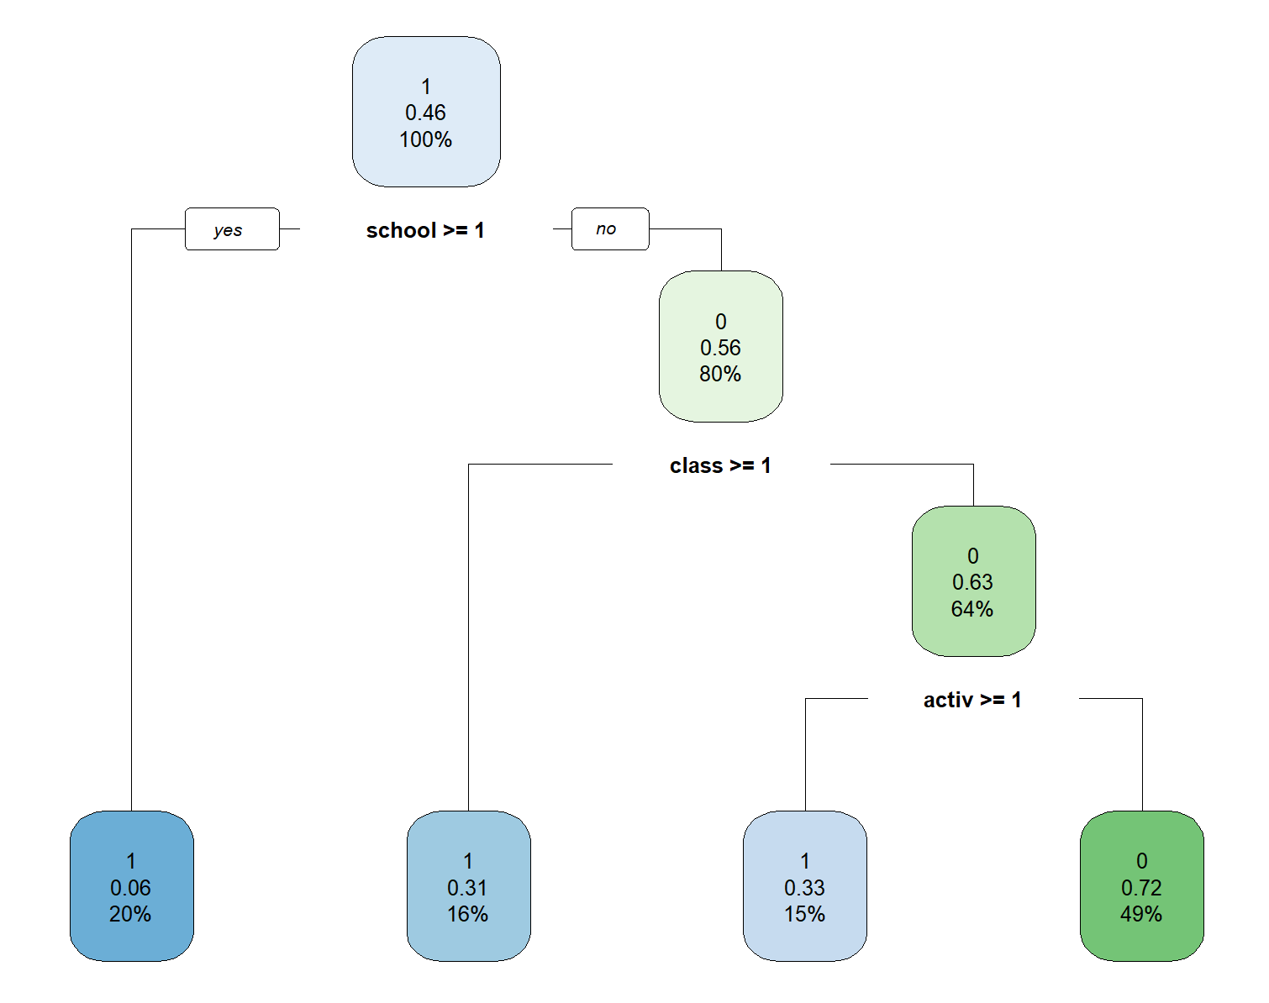
Results and Discussion
KNN Model giving 85 % accuracy
Random Forest Model giving 70 % accuracy

Slide 5
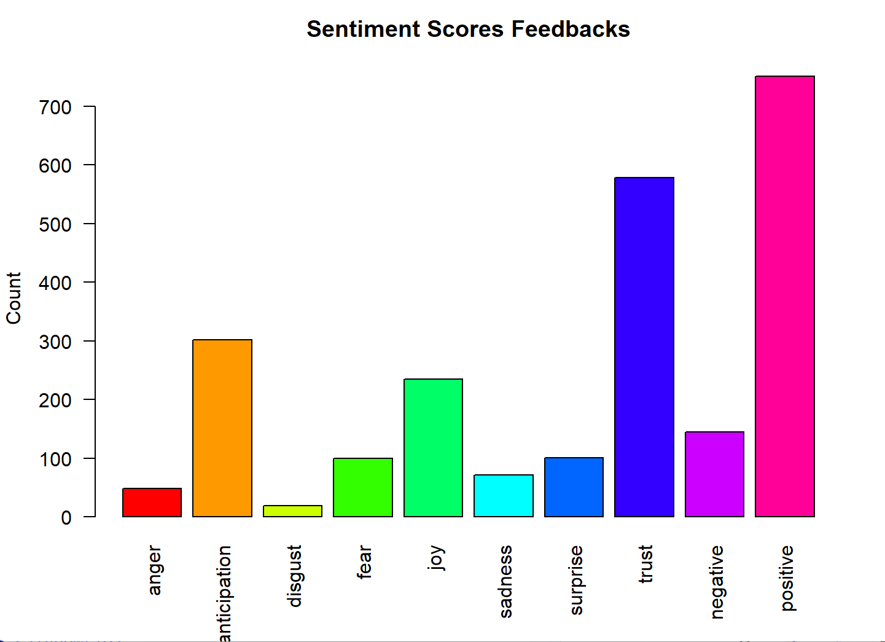
Results and Discussion
Bar graph showing the frequency of different feedbacks based on sentiment scores

Slide 6
Results and Discussion
Model | Accuracy | Recall | Precision | F-Score | Cross Validated Accuray
SVM | 74.58% | 0.98 | 0.76 | 0.86 | 86.79%
Random Forest | 75.59% | 1 | 0.76 | 0.86 | 86.58%
Bagging | 74.25% | 0.97 | 0.76 | 0.85 | 86.2%
XGBoost | 74.25% | 0.97 | 0.76 | 0.85 | 86.85%
Decision Tree | 75.59% | 0.99 | 0.76 | 0.86 | 88.18%
Naïve Bayes | 24.08%

Slide 7
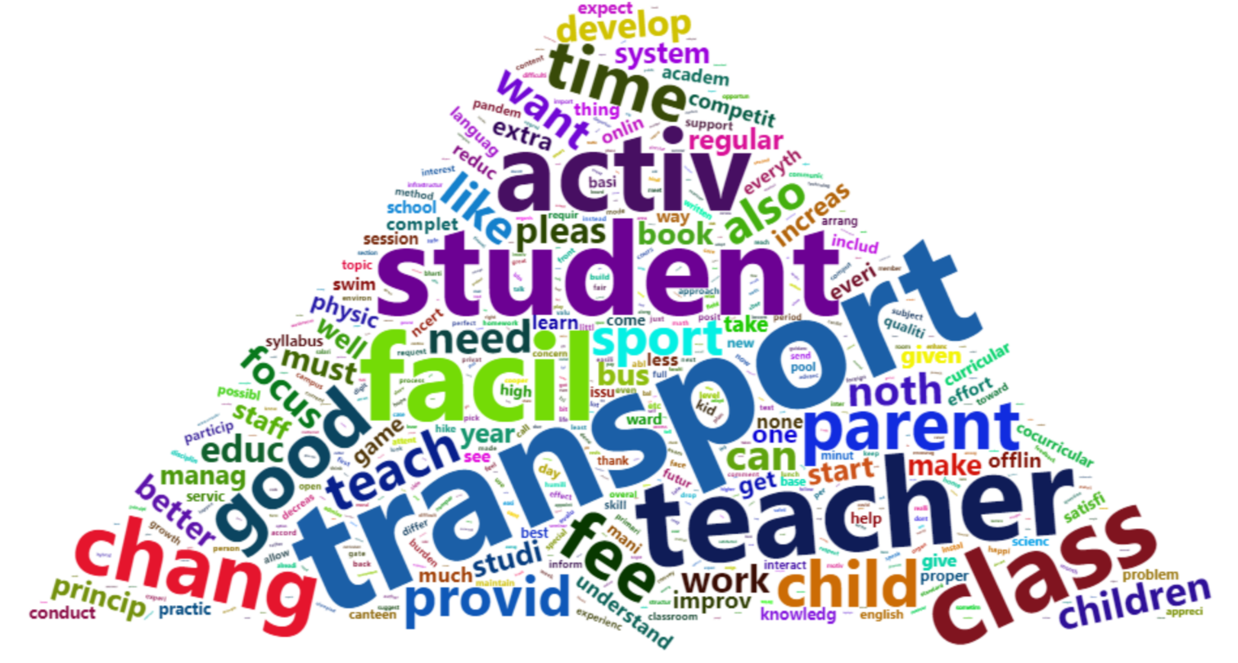
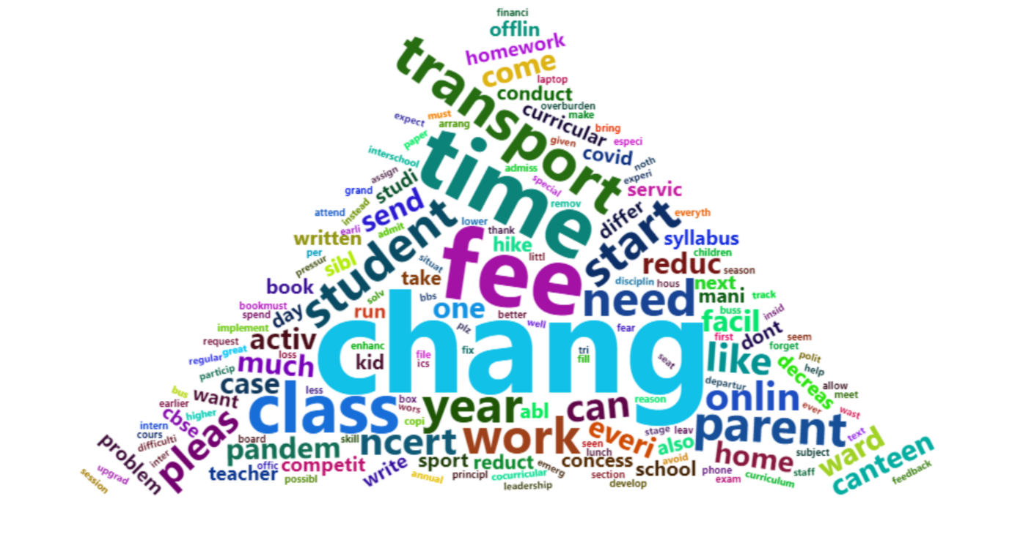
Results and Discussion
A word cloud showing the frequency of occurrence of various words in the dataset:
1: Before any analysis 2: Only negatively classified feedbacks

Slide 8
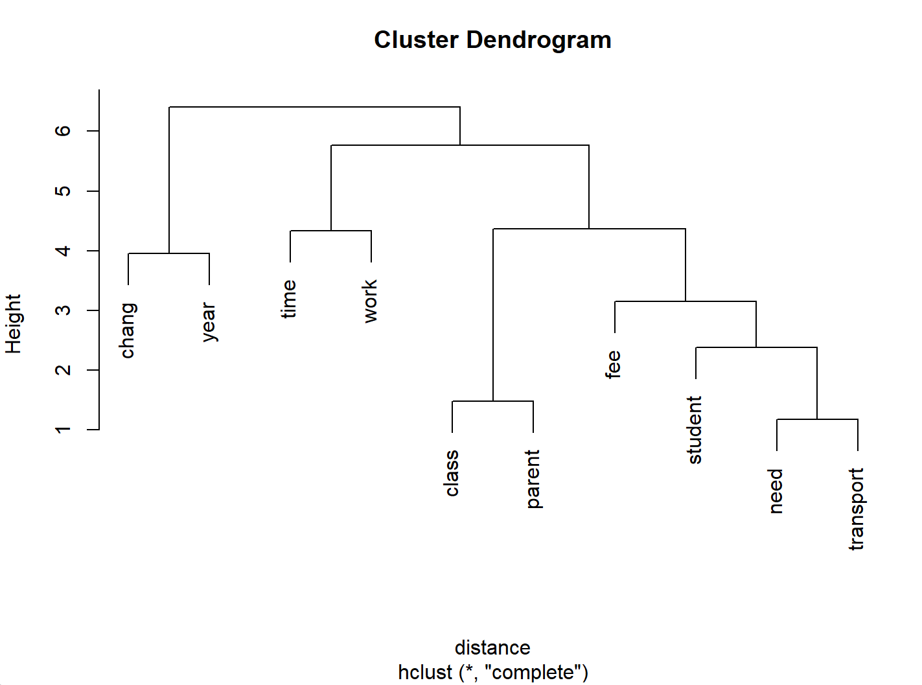
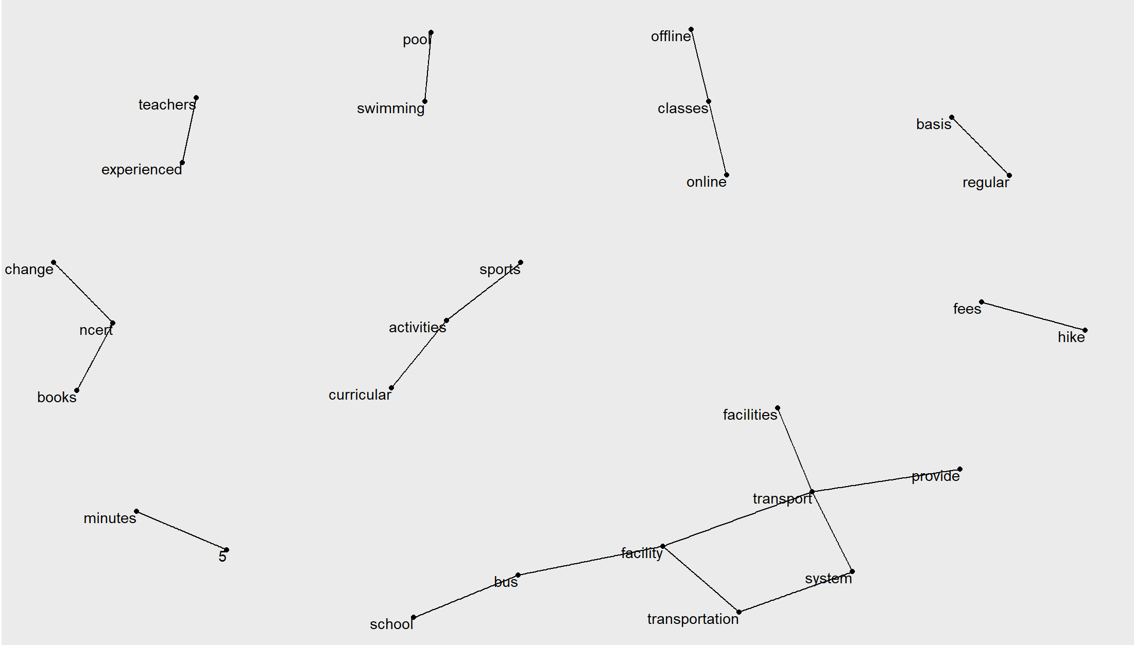
Results and Discussion
The above Dendogram gives us an idea of how the word clusters are being formed in the data. For eg., the word “need” is found most with the word “transport”. The word “time” occurs in clusters that have the word “work”.
Bigram graph showing cluster occurrences

Slide 9
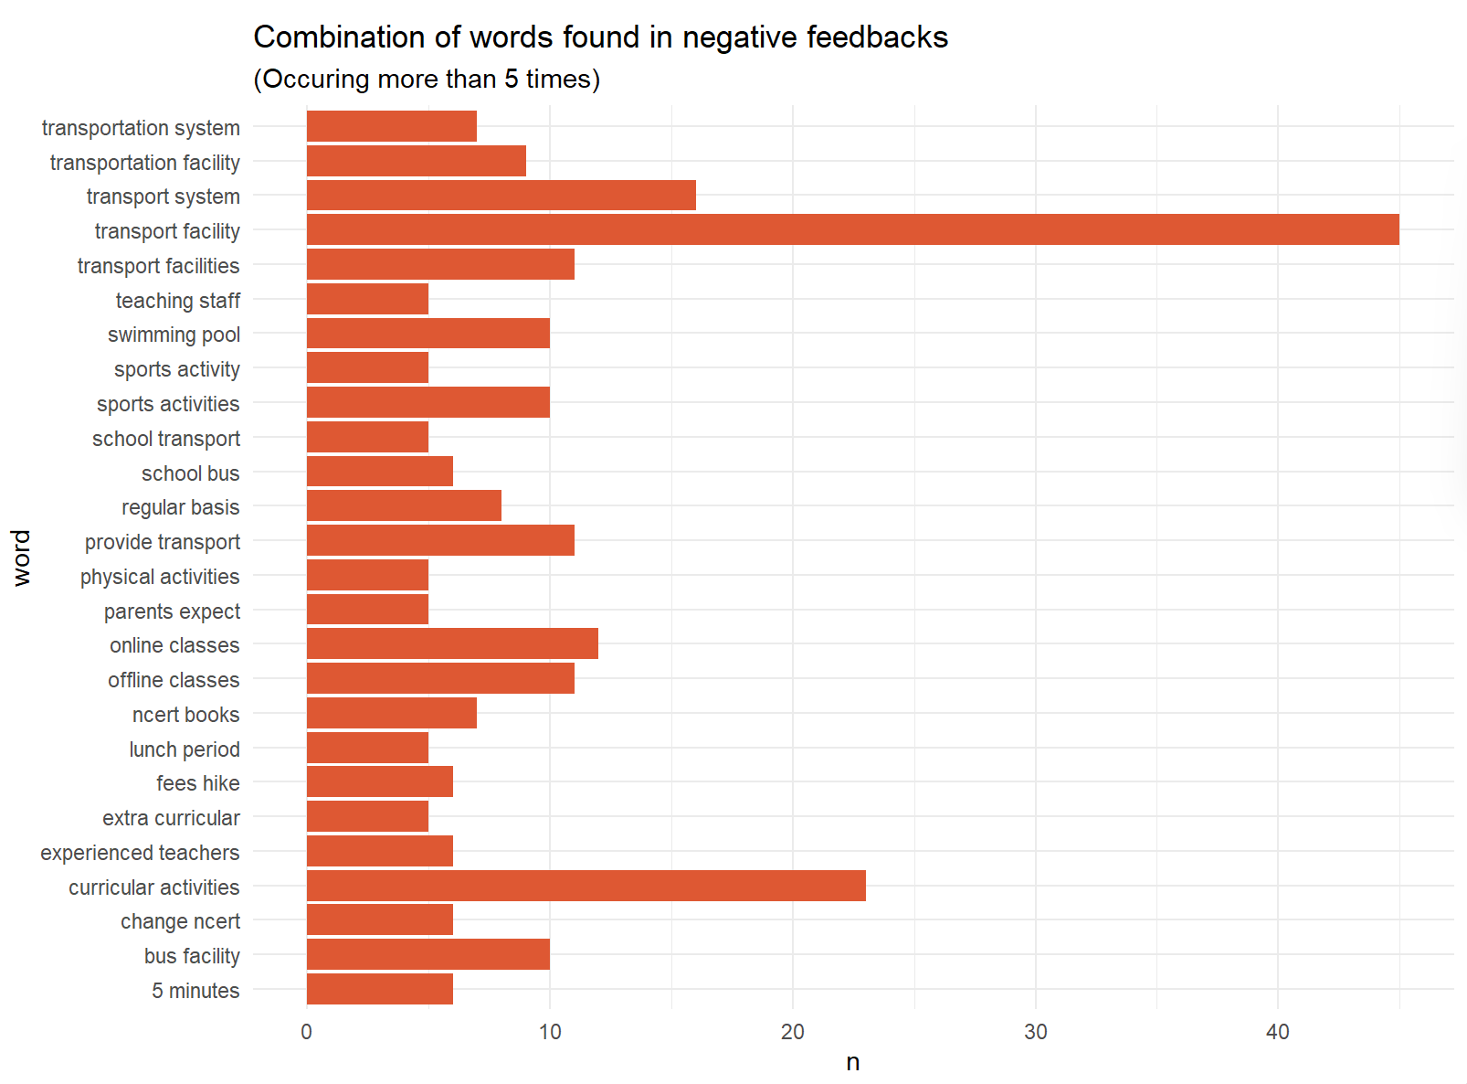
Bar graph showing the top 20 occurring bi-grams in the dataset

Slide 10
Conclusion
In conclusion, we can say that upon comparison with Random Forest, the topic detection algorithm works best with a KNN model. The sentiment analysis model gave very bad predictions with the Naïve Bayes Classifier, but the other models, namely Decision Tree, SVM, Random Forest, Bagging and XGBoost model gave good levels of accuracy.
A correlation analysis, the bi-gram graphs and cluster analysis show us the most significant issues mentioned by the stakeholders in the data. We can recommend certain points for the school to implement based on our output.
There is a need for a mode of transportation arranged by the school, eg. bus service.
The current fees hike was not well received by the stakeholders.
NCERT books need to be changed and more focus should be put on that area.
Sports activities should be included more in the curriculum.
There is a requirement of more experienced teachers.

